Slide 1
Nao improvements for SPL
Tim Cooijmans, Tim Hendriks, Dionisio Nunes, Nico Petrakis, Marc Romeyn

Slide 2
team
Dionisio Nunes
Marc Romeyn
Nico Petrakis
Tim Cooijmans
Tim Hendriks

Slide 3
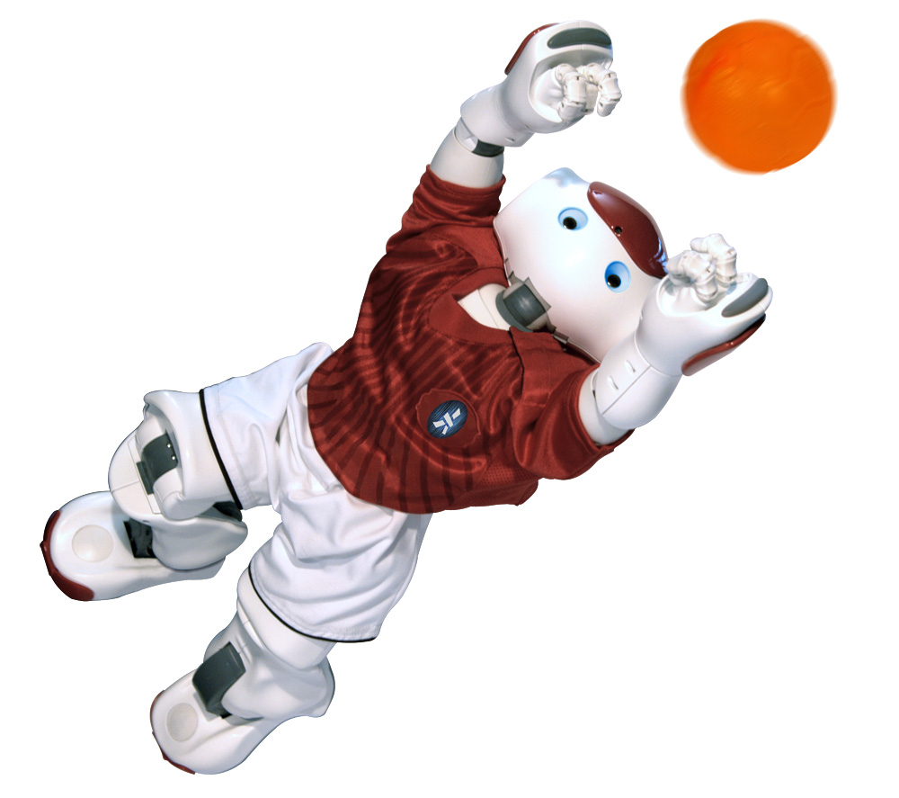
Robocup

Slide 4
Robocup
Purpose
Foster AI research
Make AI appealing
Brings many aspects of AI into light
Target
Human like football skills by 2050!!!
Awareness of challenges of robotics and AI
Means
Standardized rules
Multiples tools and platforms
Competitions to check progress

Slide 5
Overview
Vision
Aspects of vision
Ball Detection (Marc)
Goal Detection (Nico)
Kicking (Tim)
Locomotion
Walking improvement (Tim C)

Slide 6
Ball Detection
Goal:
Solid ball detection without the need of calibration
Combining color detection and circle detection
Color detection with loose color filters
Detects lots of noise
Use circle detection to find if output of color detection is ball or noise

Slide 7

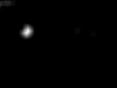
Color detection
Convert image from RGB to HSV
Hue, Saturation and Value
Threshold the image
See figure 1
Reduce noise
See figure 2
Blur
Erode
Get the brightest pixel
Figure 1
Brightest pixel
Figure 2

Slide 8
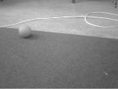
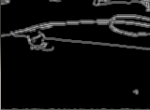
Circle detection
Convert input image to grayscale
See figure 3
Canny edge detection
See figure 4
Figure 3
Figure 4

Slide 9
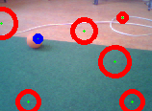
Circle detection
Smooth image
Detect circles in the image
See figure 5
Ball found if there exists a circle with
Radius between minimum and maximum radius of the ball
Distance from center to output position of the color detection < radius
Next Nico on Goal Detection
.
Output from color detection
Figure 5

Slide 10
Locating the goal
Found ball
In good position
Find goal
Circle around the ball
Threshold pixels
Goal detection video
Next Tim H on Kicking

Slide 11
Kicking
Kicking Video
Not balanced in every state
No problem because of counter movement

Slide 12
DEMO VIDEOS
Ball detection
Goal detection
Next on walking -Tim C

Slide 13
Learning to walk
The learning problem
Minimize expected distance to goal
Based on observations from the past five (or so) timesteps
By controlling joint positions and stiffnesses
High dimensionality
The policy is a function from R^270 to R^38
We will need
Lots of data
Dimensionality reduction
A good initial policy

Slide 14
Lots of data
Data collection method
Repeatedly walk to uniformly random locations
Observe sensory inputs and the actions chosen in response (at 50Hz)
Lots of data in a very narrow region of state space
Inputs
Accelerometer, gyroscope readings
Joint positions and stiffnesses
Goal location
Outputs
Desired joint positions and stiffnesses

Slide 15
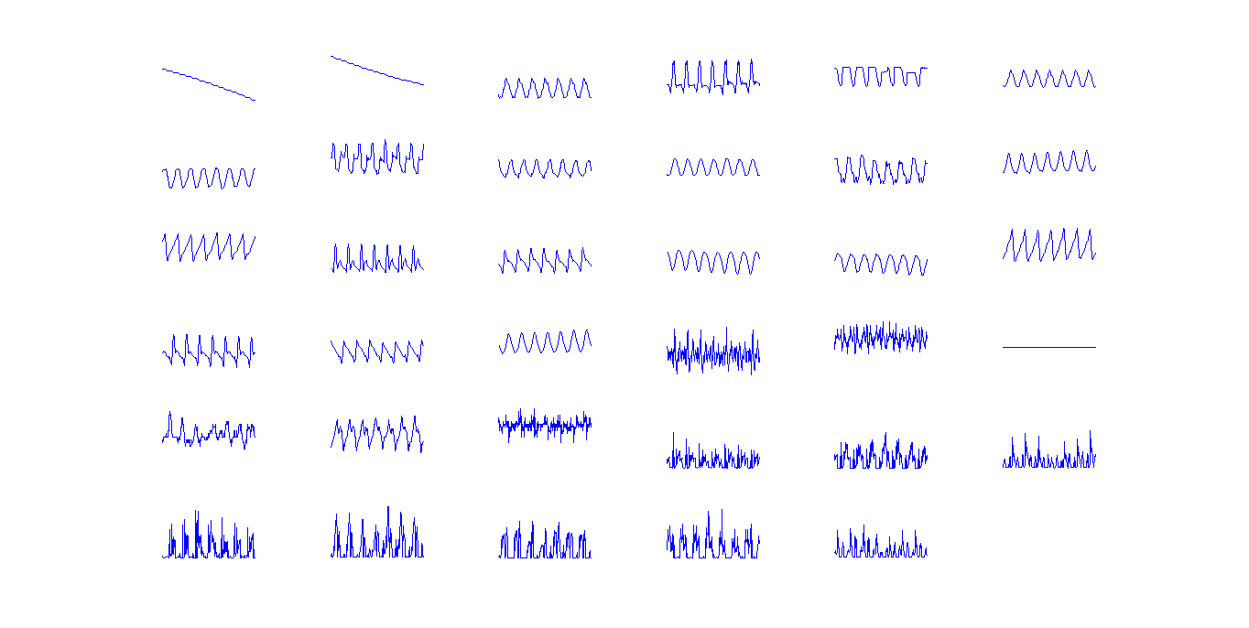
A glance at the input data

Slide 16
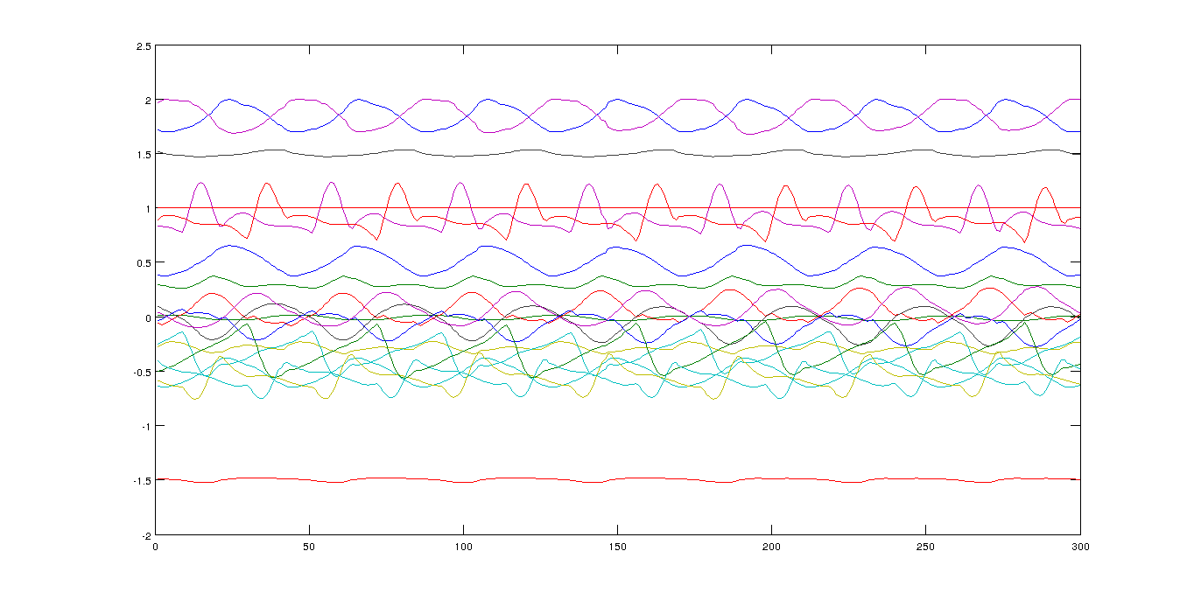
Output data

Slide 17
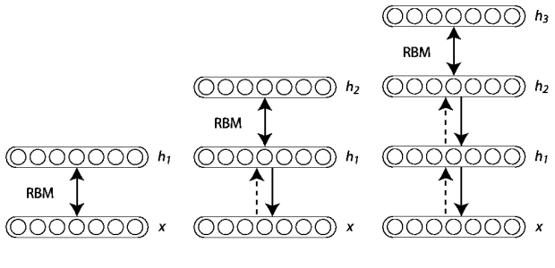
Dimensionality reduction
Deep Auto-encoders (Hinton, 2006)
Based on Deep Belief Networks (Hinton, 2006)

Slide 18
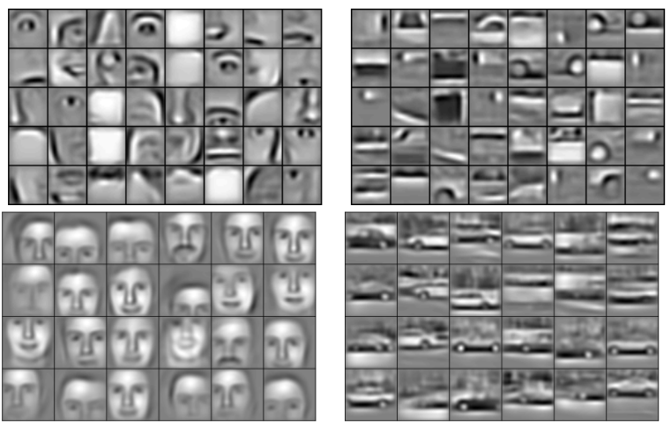
Deep features
From Honglak Lee et al. (2009)

Slide 19
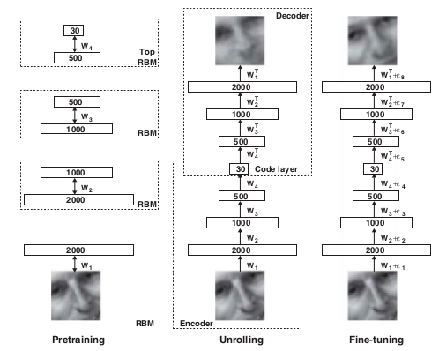
Deep Auto-encoders
From Hinton (2006)

Slide 20
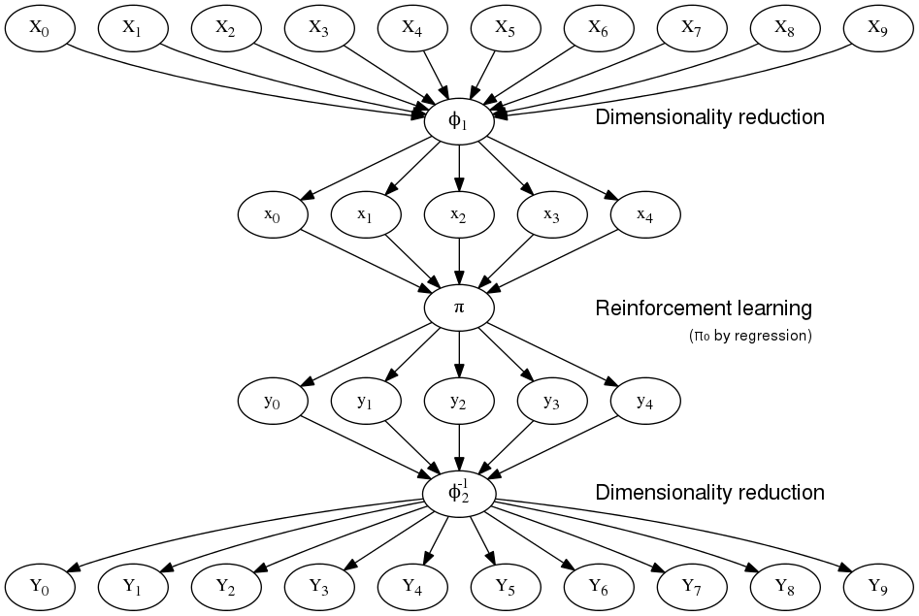
Putting it together

Slide 21
The training procedure
Start with an initial policy π₀
Gather data with the policy
Pretrain the networks
Finetune by regression to find a new policy
Improve the policy by RL using the same data
Go to 2

Slide 22
Expected difficulties
Deep belief nets are tedious to train
Limited control over the kind of features
Fine-tuning may be too little, too late
Can't use NaoQI's inverse kinematics
Which weren't that good to begin with
Reward function requires domain knowledge
Simple functions may make poor learning signal
Complex functions are likely buggy/noisy
Next to conclude –Tim H

Slide 23
conclusion
Ball and goal detection are not 100% accurate
Searching the ball takes too much time
Too less frames/sec to track rolling ball

Slide 24
Future Research
State controller
Use both cameras
Goalkeeping
Parameterized kick
Locomotion
Communication between NAO’s

Slide 25
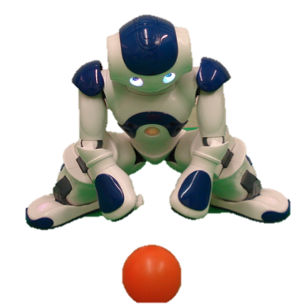
Questions?

